Slide 1

Linguistic analysis of
~ By Muskan Das

Slide 2

Contents
Goal – 1
Goal – 2
Conclusion
Related Visualizations

Slide 3
PRE-REQUISITES

Slide 4
Goal- 1
Analyzed selected dataset
Outlier detection
Applying the Linear Regression
Accuracy – 0.798123
Evaluation Matrix -
a) MSE : 7.59384
Selected Data
MSE & R2
LinearRegression

Slide 5
Comparison Of Other Models and Predictions
Support Vector Machine : -
Accuracy of 0.24516 ; MSE of 12.8974
Random-Forest Classifier :-
Accuracy of 0.38490 ; MSE of 13.863
Decision – Tree Classifier :-
Accuracy of 0.5416 ; MSE of 11.263

Slide 6
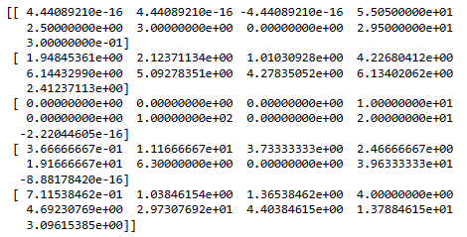
Goal - 1i
Applying the outlier dataset with Kmeans clustering for analysis
Data helps analyze how each psychological emotion words tallied with time orientation helps detecting psychology of the person.
Changes with their thinking pattern for getting employed over time orientation features

Slide 7
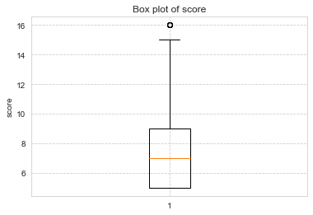
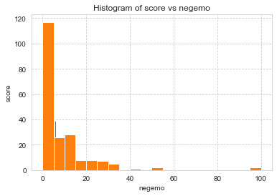
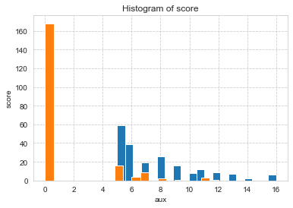
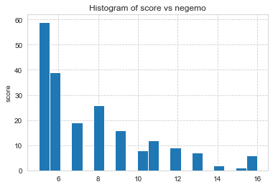
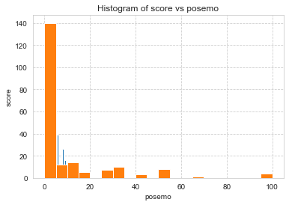
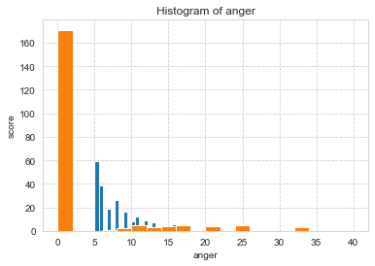

Slide 8
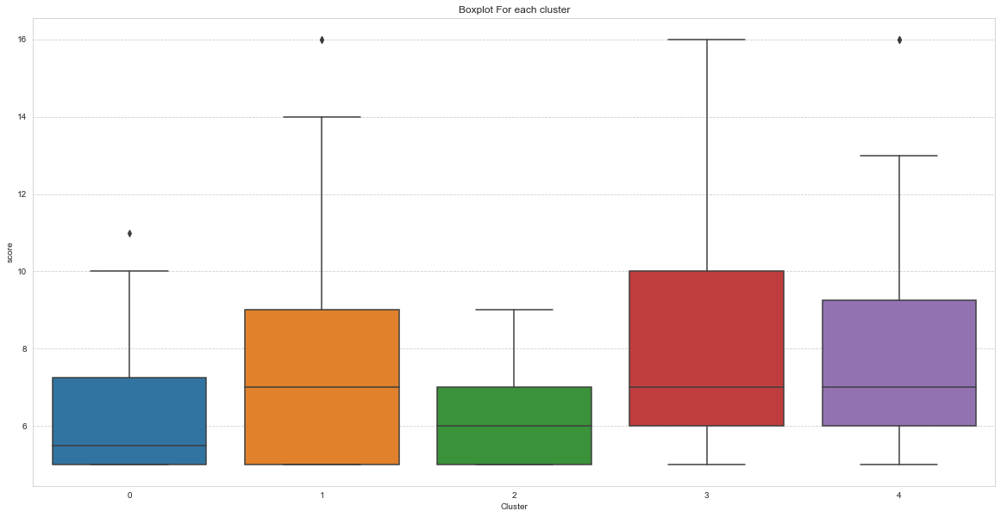
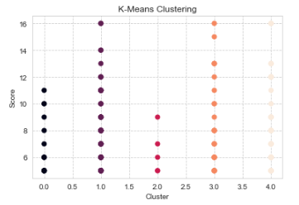
Clustering with Features – ( anx, sad, anger, negemo, posemo, cogproc, focuspast, focuspresent, focusfuture)

Slide 9
Conclusion
Linear Regression gives the best accuracy rate than other models
The clusters help determine – a) The emotion of the person at which time frame was it high
b) Person having high anxiety or sad emotion in the present, past, or future tends to use those words in that particular time orientation feature

Slide 10

Thank you!

